Slide 1
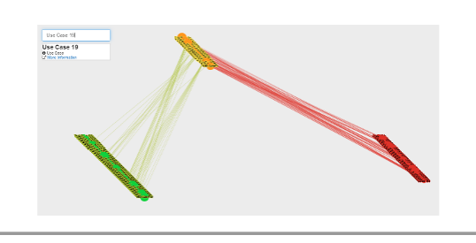
Interactive Traceability Links Visualization using Hierarchical Trace Map
Thazin Aung

Slide 2
Agenda
What is Hierarchical Trace Map Visualization?
What it is for?
Motivation Scenario
How the visualization components work?
Processing Steps to Generate Data
Visualization Demo

Slide 3
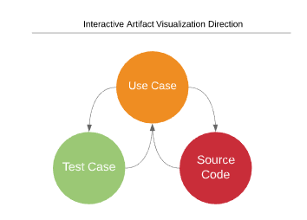
What is Hierarchical Trace Map Visualization
It is a visualization technique which assist in visualizing interrelation between use case, source code and test case in one area interactively to understand the current state of the system.

Slide 4


What it is for?
1. Change Request
2. Understand Software Change and Determine Impact
3. Design the software change
4. Implement Software Change
5. (Re) Test Affected Software
Software Change Impact Analysis
“the assessment of the effect of changes – provides techniques to address this problem by identifying the likely ripple-effect of software changes and using this information to re-engineer the software system design”
(Shawn Bohner 1996, p.67)

Slide 5
Change Impact Analysis Scenario
How change impact analysis normally do in software development projects?

Slide 6
How the visualization components works? Processing Part - 1
Vector Space Model (VSM)
Algebraic Model first proposed by Gerard Salton (PhD Harvard)
First used in SMART (System for the Mechanical Analysis and Retrieval of Text) Information Retrieval System in Cornell University in 1960
In Requirement Engineering Context, VSM technique started in popular in early 21st Century mainly for automatic trace links recovery
It is mainly used for document-to-document relationship recovery

Slide 7


How the visualization components work? Processing Part - 2
In VSM, Documents are represented as Vectors
To Implement Vector Model
First, It presents documents into vector of words
Then, Transform to numeric form as that we can do text mining
VSM
Presents

Slide 8
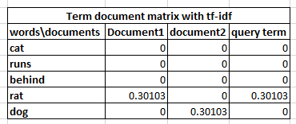

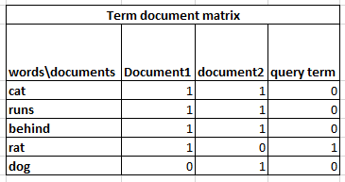
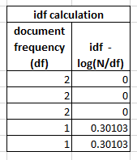
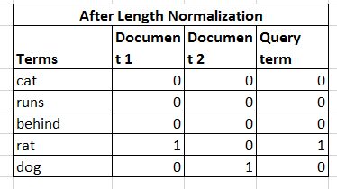
How the visualization components works? Processing Part - 3
Term Document Matrix
Tf-idf = tf x idf tf = term frequency is the number of times a term occurs in a document idf = inverse of the document frequency, given as below idf = log(N/df), where df is the document frequency-number of documents containing a term

Slide 9
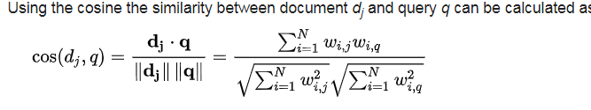
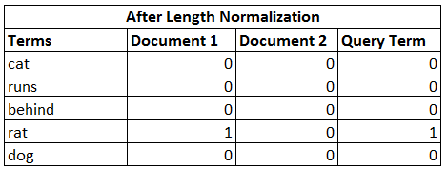
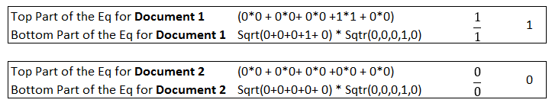
How the visualization components works? Processing Part - 3
Similarity Measures : Cosine Similarity

Slide 10
How the visualization components works? Visualization
Hierarchical Trace Map Visualization Demo

